Slide 1
GIFTED AND TALENTED EDUCATION Challenges & Expectations
„No country can afford to waste talent, to lose the human wealth, no country is so rich to waste talents of its citizens” (Cieślikowska 2005)
Dr Marcin Gierczyk
Department of Pedagogy and Psychology
University of Silesia (Poland)

Slide 2
Why Gifted and Talented education should be important for us?
It is worth mention that today's gifted students are tomorrow's social, intellectual leaders of economy and culture, and their development can not be left to a chance (Eyre 2009, p. 1048, 1051).
Increasingly emphasize the role of gifted people in shaping the post-modern societies (Dyrda, 2012).
In many of today's job advertisements, employers among the candidates for the job are looking for gifted individuals, those outstanding from the crowd.
We can therefore say that the market has been intensified by increased international economic competition which has led to a kind of war for gifted and talented individuals. Companies see their future competitiveness as dependent of a small number of highly gifted people, drawn from a global pool (Brown, Tannock, 2009, source: Smith, 2014, p. 209).

Slide 3
Definitions and Concepts of Giftedness
Over 120 definitions (Lambert, 2010)
“The way we define a Gifted and Talented child depends on what you are looking for in him” (Freeman, 2005)
What seems to be worth mentioning, though, is the fact that each of the gifted concepts is a vision of an author’s beliefs (Strenberg, 2004)
Today, undoubtedly it is not only the intelligence affects the development of talent. It is widely known that environment and the inner motivation plays an important role as well

Slide 4
DIAGNOSIS AND EVALUATION OF SYSTEM SOLUTIONS IN THE FIELD OF GIFTED AND TALENTED EDUCATION ON THE EXAMPLE OF ENGLAND AND POLAND. COMPARATIVE STUDY

Slide 5
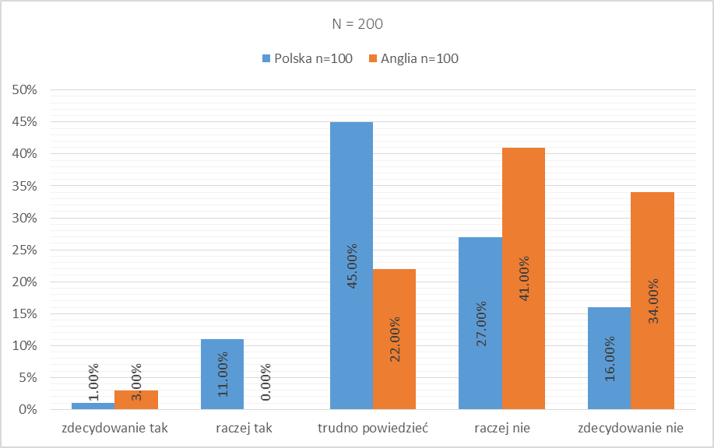
What features - according to teachers - characterize an able/talented/gifted student?
DEFINITELY YES RATHER YES DIFFICULT TO SAY RATHER NOT DEFINITELY NO
Features:low interpersonal skills, antisocial behaviour, lack of immunity to criticism

Slide 6
Diagnosis and criteria for identification of gifted students
CRITERIA | ENGLISH TEACHERS' ANSWERS N=100 | POLISH TEACHERS' ANSWERS N=100
SPECIFIC ABILITIES IN A GIVEN FIELD | 66% | 25%
EXCELLENT ACADEMIC PERFORMANCE | 77% | 14%
OUTSTANDING ACHIEVEMENTS IN CONTESTS AND COMPETITIONS | 37% | 26%
Q: Which of these criteria are paramount when selecting gifted students in your school?

Slide 7
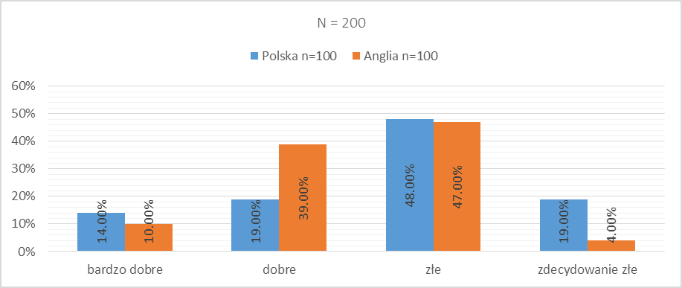
Separate schools for gifted and talented students
VERY GOOD SOLUTION GOOD SOLUTION BAD SOLUTION IT IS DEFINITELY A BAD SOLUTION
Q: What do you think about creating separate schools for able students only?

Slide 8
Concerns related to the creating separate schools for gifted students?
Creating stereotypes in society about better and worse students - those from better schools and worse schools
Parent reactions

Slide 9
Talented and Gifted Teaching Methods
England
N=100
97%
individual work in the classroom
93%
Use own curricula
95%
presentation of skills and achievements of able students
Poland N=100
83%
organising extracurricular activities
81%
preparing students for contests and competitions
63%
additional tasks (essays, thematic presentations)
Q: How do you conduct tasks connected to teaching gifted students?

Slide 10
The most effective forms and methods of work with gifted students
Poland
N =100
84%
motivation to participate in competitions
72 %
individual consultations
England N=100
81%
independent students’ work on problems that go beyond the curriculum,
53%
encouraging students to independent participation in extracurricular events
Q: Among the following forms and methods of work with able students, please select a maximum of three that you believe are most effective:

Slide 11
Evaluation of legal solutions in the field of gifted and talented education
Evaluation | ENGLISH TEACHERS' ANSWERS N=100 | POLISH TEACHERS' ANSWERS N=100
DEFINITELY YES | 4% | 2%
RATHER YES | 31% | 20%
DIFFICULT TO SAY | 52% | 47%
RATHER NOT | 13% | 31%
Total | 100% | 100%
Q: Do you think that the legal solutions in England concerning gifted students are sufficient?

Slide 12
School support
Evaluation | ENGLISH TEACHERS' ANSWERS N=100 | POLISH TEACHERS' ANSWERS N=100
DEFINITELY YES | 50% | 10%
RATHER YES | 47% | 46%
DIFFICULT TO SAY | 2% | 34%
RATHER NOT | 1% | 10%
TOTAL | 100% | 100%
Q: Do you think that your school offers sufficient aids for gifted students?

Slide 13
Barriers that cause the problems
England N=100
43%
lack of adequate staff
47%
passivity of teachers, occupational burnout – teachers might be too overworked
Poland N=100
67%
passivity of the authorities that fund schools
47%
complicated process of applying for specific solutions
Q: What you think are the barriers that cause the problems associated with the lack of action taken in the field of educating able students?

Slide 14
School support
English students | Polish Students
Criticism of 'gifted' label Subjective treatment | Failure to implement supporting activities, Overcrowded classes.
Teachers were rated favourable The same experiences as regards the functioning in peer group
Positive school rating | Negative school rating

Slide 15
CONCLUSIONS
POSITIVE CONCLUSIONS
Creating programs that ensure the development of gifted individuals.
Implementation of EU recommendations.
Systemic assumptions, methods of working with gifted students, their identification, education and support are broadly similar.
NEGATIVE CONCLUSIONS
The English system is effective but only within the theoretical dimension.
Poland insufficiently supports the education of gifted students.
In the Polish system, the teacher and his training tend to be forgotten.

Slide 16
Recommendations
Drafting of recommendations for university lecturers regarding of identification and support of gifted students and shaping their awareness of their abilities.
Research on psychological and teaching experiences of gifted students on a larger scale.
Education of Polish teachers regarding various possibilities of methodical support for gifted students.
Each masters in education student should be endowed with expertise in the field of pedagogy and psychology of abilities.
Encourage teachers to greater autonomy in using their own programs for working with a gifted student.

Slide 17
Both systems give interesting partial solutions that need to be refined.
A collaboration of representatives of the Polish and English system can positively influence the application of optimal solutions to support a gifted student under the specific educational system.

Slide 18
